Slide 1
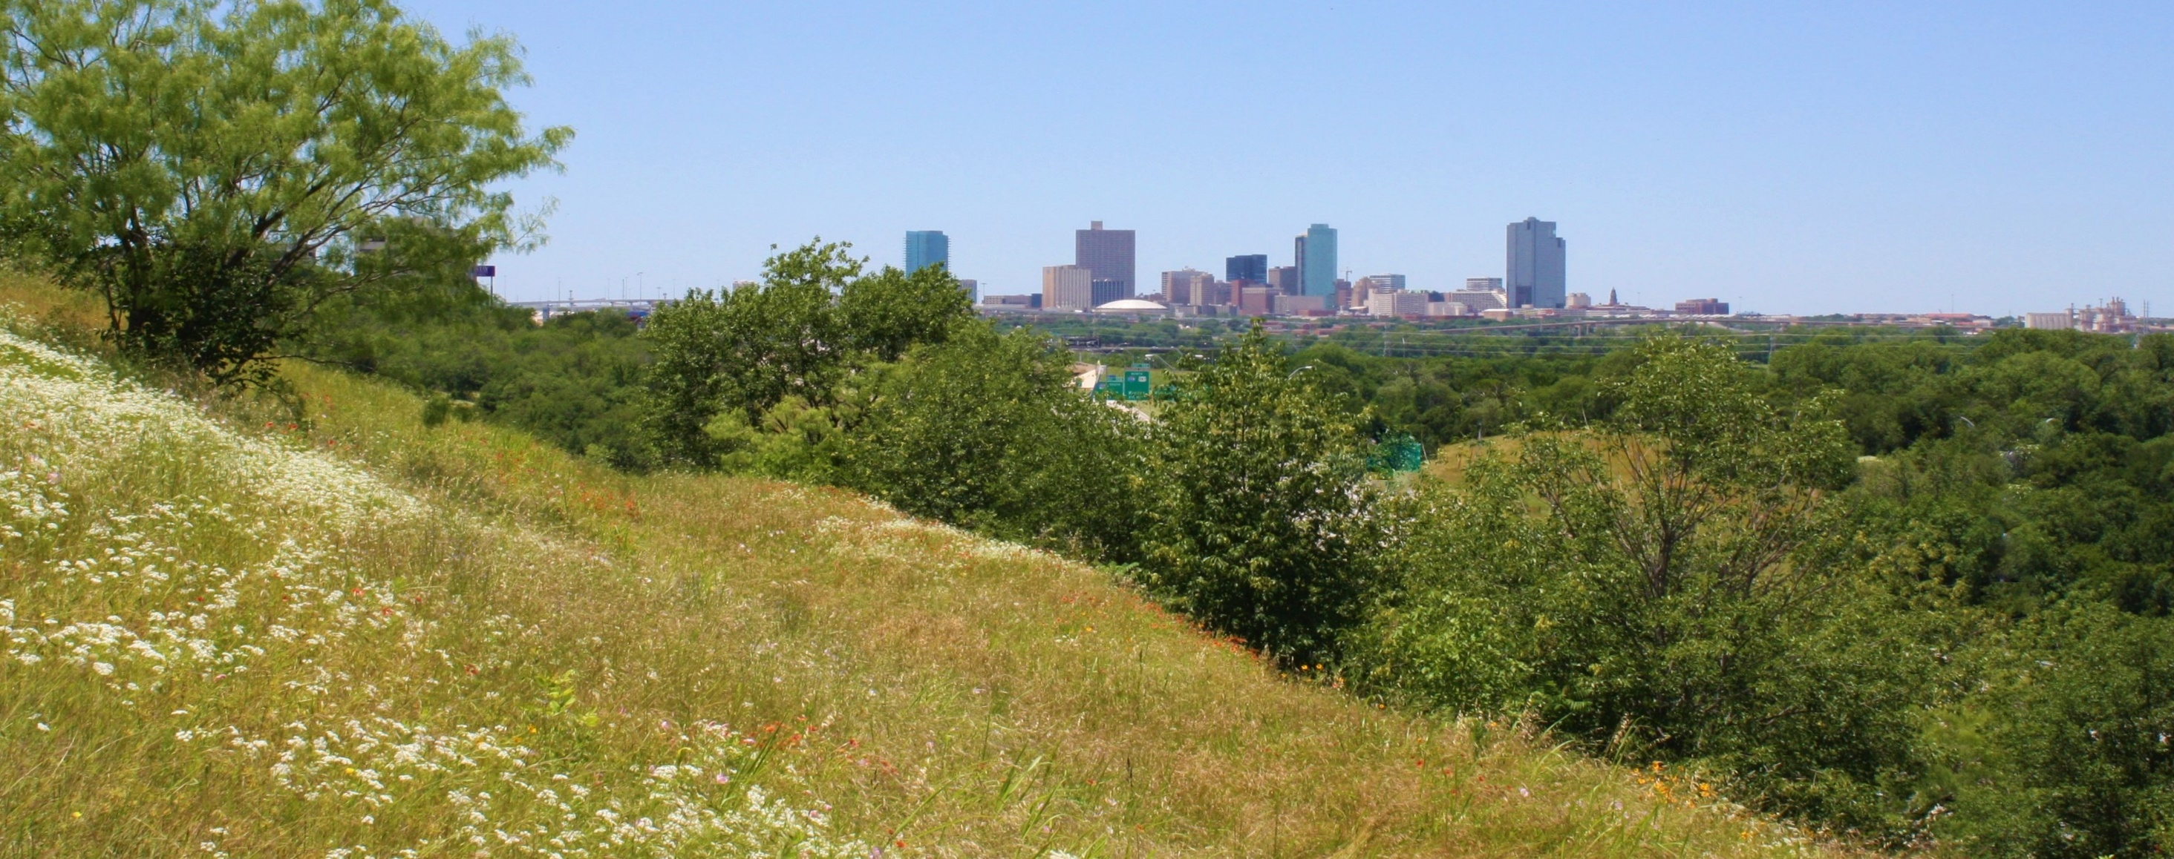
East Lancaster Public Improvement District 20
Annual PID Meeting
August 5, 2021

Slide 2
Welcome
PID 20 Members
Notes:
Section title slide option a

Slide 3
PID Annual Meeting
Agenda Review
Today’s Topics
Welcome and Introductions
Board Introductions and role review
City of Fort Worth PID Administration
Management introductions and role review
Guest Speakers
Barry Smith- PID 20 Advisory Board Member
SGT Dalton Webb – Fort Worth Police Department
Scott Westmoreland- Texas Industrial Security
2020-2021 Budget Review
Open Forum for Discussion
Adjournment
Notes:
Interior content slide

Slide 4
Welcome & Introductions
PID 20 Advisory Board
PID 20 Advisory Board Members
Barry Smith
Bill Kiker
Dale Uberman
Debbie Hobbs
Jason Ray
Notes:
Interior content slide with photo

Slide 5
Welcome & Introductions
City of Fort Worth
City of Fort Worth Administration
Crystal Hinojosa- Senior Contract Compliance Specialist- PID Administrator
Terri Terry- Accountant for PIDs
Robert Sturns – Director of Economic Development
Notes:
Interior content slide with photo

Slide 6
Welcome & Introductions
Management Contractor
Management through FirstService Residential
Robin Willits- General Manager
Davita Harless- Client Accountant
Kendall S. Abbott, SCM, CMCA, AMS, DCAL Senior Regional Director
Notes:
Interior content slide with photo

Slide 7
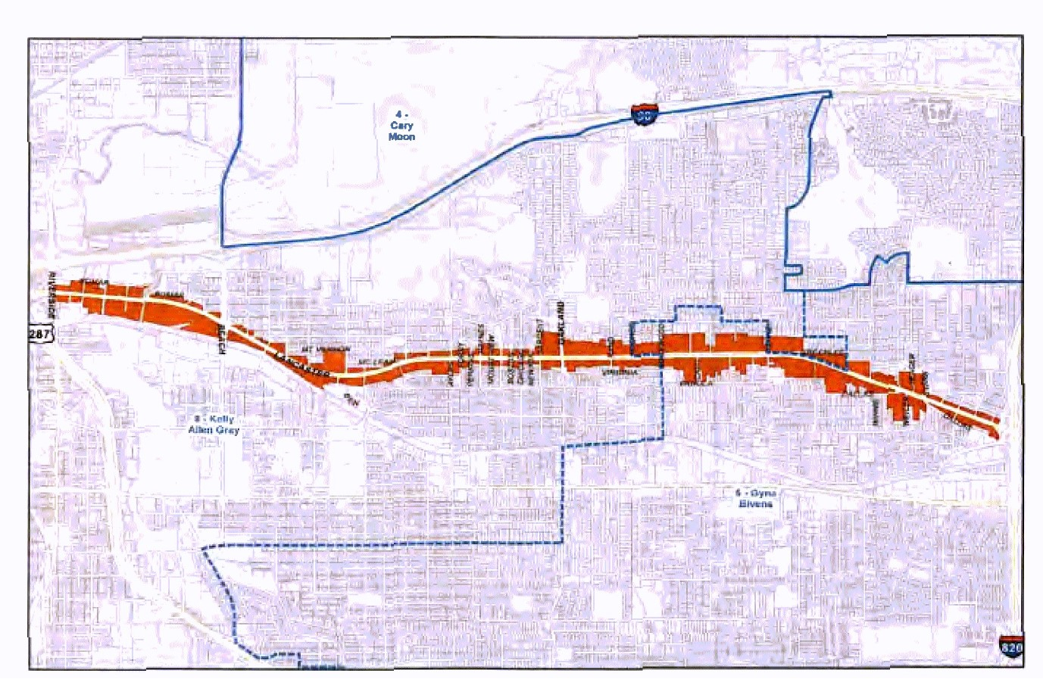
Where is PID 20?
PID 20 was established February 12, 2019 for a 10-year term, expiring September 30, 2029. The PID Assessment rate is $0.266 per $100 of assessed value. The PID consist of approximately 243 acres of land. PID Boundaries are from the East Curb of Riverside Drive to the Western Edge of Interstate Loop 820.
Notes:
Interior content slide with photo

Slide 8
Guest Speakers
PID 20 Annual Meeting
Barry Smith
PID 20 Advisory Board Member
Barry has been a member of the PID 20 Advisory Board since January 2020. He owns several businesses within the PID.

Slide 9
Guest Speakers
PID 20 Annual Meeting
Since the PID launched with security patrols on Valentine’s Day 2020, we can measure success by three important metrics:
We have achieved a substantial and obvious reduction in vagrants and transients.
The 2020 crime rate dropped by nearly 30%, while the city as a whole saw a 2.8% drop.
We saw a dozen new businesses open in the last year, including a new 10,000 SF health clinic for seniors, a new hardware store, and Lady and the Pit Barbeque, which was just featured in Fort Worth Magazine.

Slide 10
Guest Speakers
PID 20 Annual Meeting
While these are successes, there is still a perception problem for many:
The perceived crime rate does not match the actual crime rate.
Just 1 ½ incidents rise to the level of a police report in a typical 24-hour period within the PID.
Visually the street tells a different story, and that is incumbent on the property owners to address:
Owners need to take a look at their property with “new eyes” and address property maintenance issues.
The PID website’s Resources tab lists various programs that can offset the cost of improvements for owners, such as the Façade Improvement Program.

Slide 11
Guest Speakers
PID 20 Annual Meeting
We are also addressing perceptions by marketing the street for redevelopment:
Economic Development team offered suggestions to improve the PID website design.
Website includes information about successes and various initiatives on the home page.
Drone video highlights some of the bright spots along the street and gives the website a positive feel.
www.pid20.org

Slide 12
Guest Speakers
PID 20 Annual Meeting
Sergeant Dalton Webb #3528
Fort Worth Police Department
Intelligence Exchange Section
Real Time Crime Center Supervisor
Dalton.Webb@FortWorthTexas.Gov

Slide 13
Guest Speakers
PID 20 Annual Meeting
From July 4th to Aug 2nd we’ve scanned 1,010,488 license plates on E Lancaster on the 8 cameras.

Slide 14
Guest Speakers
PID 20 Annual Meeting
We’ve received 855 hits in the past 30 days. Of those, 38 were stolen vehicles, 79 were high priority felony warrants, 2 of them were missing persons. Most notably, we had a prolific bank robbery suspect that was robbing banks in the Hurst, Euless Bedford area. We put his plate into Flock and within 2 hours we received a hit on one of the E Lancaster cameras. Our Directed response team got into a vehicle pursuit with him after we dispatched them to the hit.

Slide 15
Guest Speakers
PID 20 Annual Meeting
Scott Westmoreland – Director of Operations & Sales
Texas Industrial Security, Inc. - Security Vendor
817-335-3046 (Office)

Slide 16
First 6mth average contacts per week 387
Previous 6mth average contacts per week 163
From beginning average contacts per week 264

Slide 18
Hot Spots previous 6mths
total # of contacts 1743
Address / Name | # of contacts | % of total contacts
1801 / A-1 Food Mart | 681 | 39.1%
2536 / 7-Eleven | 353 | 20.3%
2640 / Net FW - City Center | 66 | 3.8%
4125 / PLS Check Cashing | 65 | 3.7%
2010 / Inspriring Temple fo Praise | 64 | 3.7%
4749 / Ace Cash Express | 64 | 3.7%
4217 / Dollar Tree | 56 | 3.2%
Total | 1293 | 74.2%

Slide 19
Hot Spots 1st 6mths vs Current
Address / Name | 1st 6 mths | current | change
1801 / A-1 Food Mart | 528 | 681 | 153
2536 / 7-Eleven | 145 | 353 | 208
2640 / Net FW - City Center | 169 | 66 | -103
3227 / Rapido - TL Food Mart | 232 | 1 | -231
5549 / Conoco | 174 | 2 | -172

Slide 20
PID 2020-2021 Budget
To be approved by City Council
Notes:
Interior content slide

Slide 21
Open Forum
Questions and Answers
Open Discussion
Questions for the board, management, city or police/security

Slide 22
Thank you for attending
PID 20 Annual Meeting
Notes:
Section title slide option a

