Slide 1
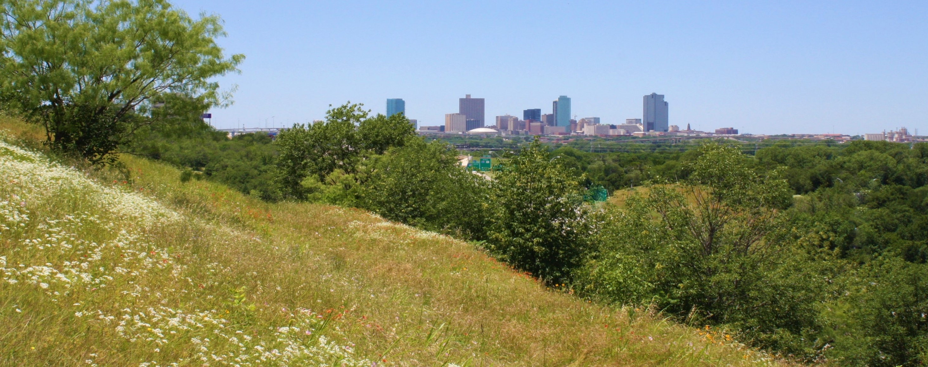
East Lancaster Public Improvement District 20
Annual PID Meeting
August 6, 2020

Slide 2
Welcome
PID 20 Members
Notes:
Section title slide option a

Slide 3
Virtual Annual Meeting
Let’s Talk Ground Rules
This is new!
Sign in process (Chat Box)- name, address and email needed (can send to host privately)
Mute automatic at entry
No action needed from you, you can watch and listen
Comments and questions in the chat box
If you leave early, you’ll have to sign in again to get back in
Be neighborly in your comments and questions
HERE WE GO!
Notes:
Interior content slide

Slide 4
Inaugural Annual Meeting
Agenda Review
Today’s Topics
Call to Order
Welcome and Introductions
Board Introductions and role review
City of Fort Worth PID Administration
Management introductions and role review
Guest Speakers
Commander Leonard Elgin- Fort Worth Police Dept.
Scott Westmoreland- Texas Industrial Security
Dan Haase- PID 20 Supporter and Enthusiast
2020-2021 Budget Review
Open Forum for Discussion
Adjournment
Notes:
Interior content slide

Slide 5
Welcome & Introductions
PID 20 Advisory Board
Inaugural Board Members & Terms
Bill Kiker- Jan 2020- Sept 2021
Dale Uberman- Jan 2020- Sept 2021
Debbie Hobbs- Jan 2020- Sept 2021
Jason Ray- Jan 2020- Sept 2022
Barry Smith- Jan 2020- Sept 2022
Notes:
Interior content slide with photo

Slide 6
Welcome & Introductions
City of Fort Worth
City of Fort Worth Administration
Tony Rousseau- Assistant Finance Director, Accounting and Financial Reporting
Kate Perry- Accounting Services Supervisor, Accounting Division
Crystal Hinojosa- Senior Contract Compliance Specialist- PID Administrator
Terri Terry- Accountant for PIDs
Notes:
Interior content slide with photo

Slide 7
Welcome & Introductions
Management Contractor
Management through FirstService Residential
Robin Willits- General Manager
Davita Harless- Client Accountant
Kendall S. Abbott, SCM, CMCA, AMS, DCAL Regional Director
Notes:
Interior content slide with photo

Slide 8
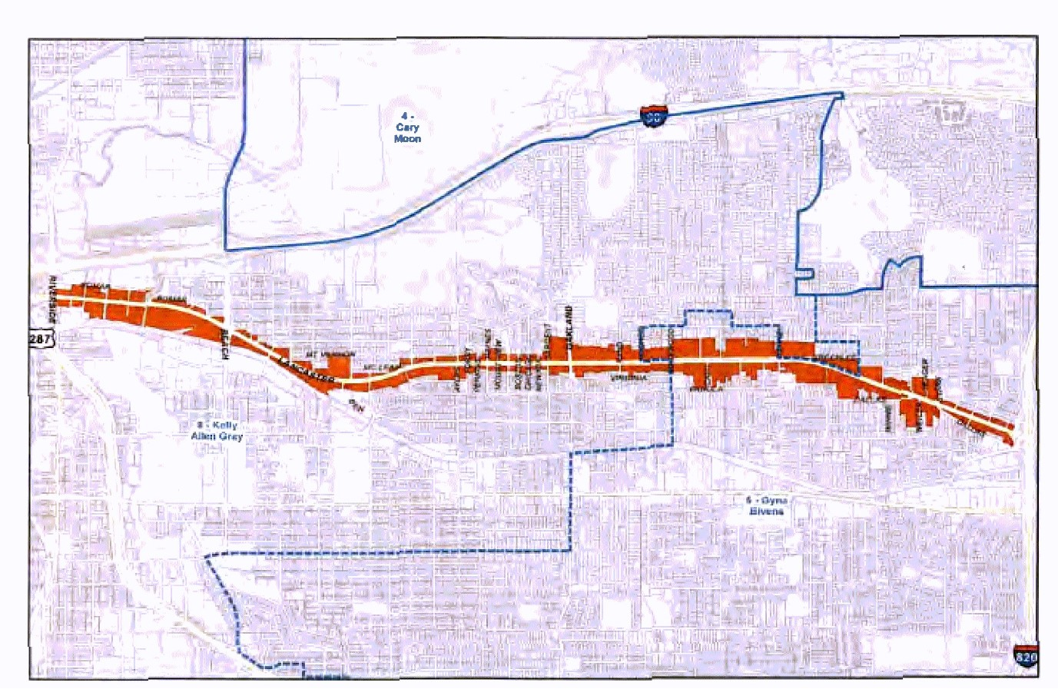
Where is PID 20?
PID 20 was established February 12, 2019 for a 10-year term, expiring September 30, 2029. The PID Assessment rate is $0.266 per $100 of assessed value. The PID consist of approximately 243 acres of land. PID Boundaries are from the East Curb of Riverside Drive to the Western Edge of Interstate Loop 820.
Notes:
Interior content slide with photo

Slide 9
Guest Speakers
PID 20 Annual Meeting
Commander Leonard E. Elgin
Fort Worth Police Department, East Division
817-392-4644 (Office)
682-402-0729 (Mobile)
Leonard.elgin@fortworthtexas.gov

Slide 10
Guest Speakers
PID 20 Annual Meeting
Scott Westmoreland – Director of Operations & Sales
Texas Industrial Security, Inc. - Security Vendor
817-335-3046 (Office)

Slide 11
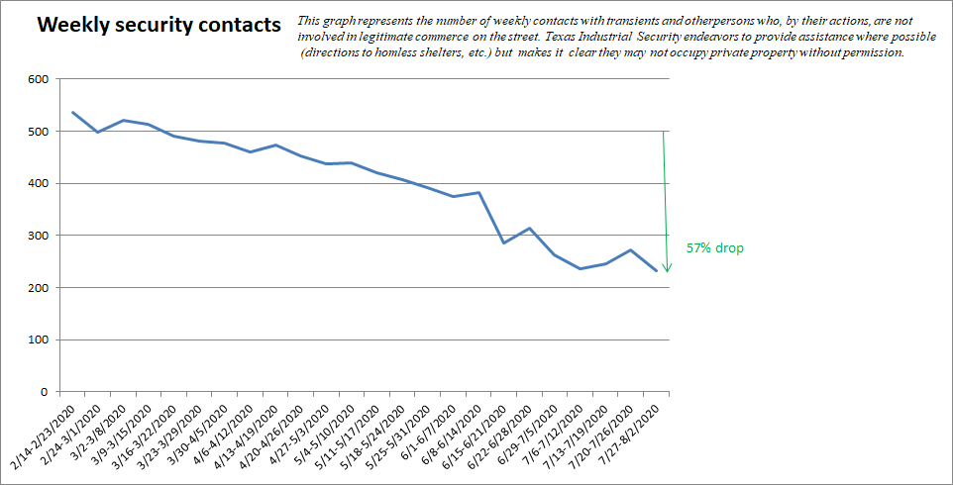
Guest Speakers
PID 20 Annual Meeting

Slide 12
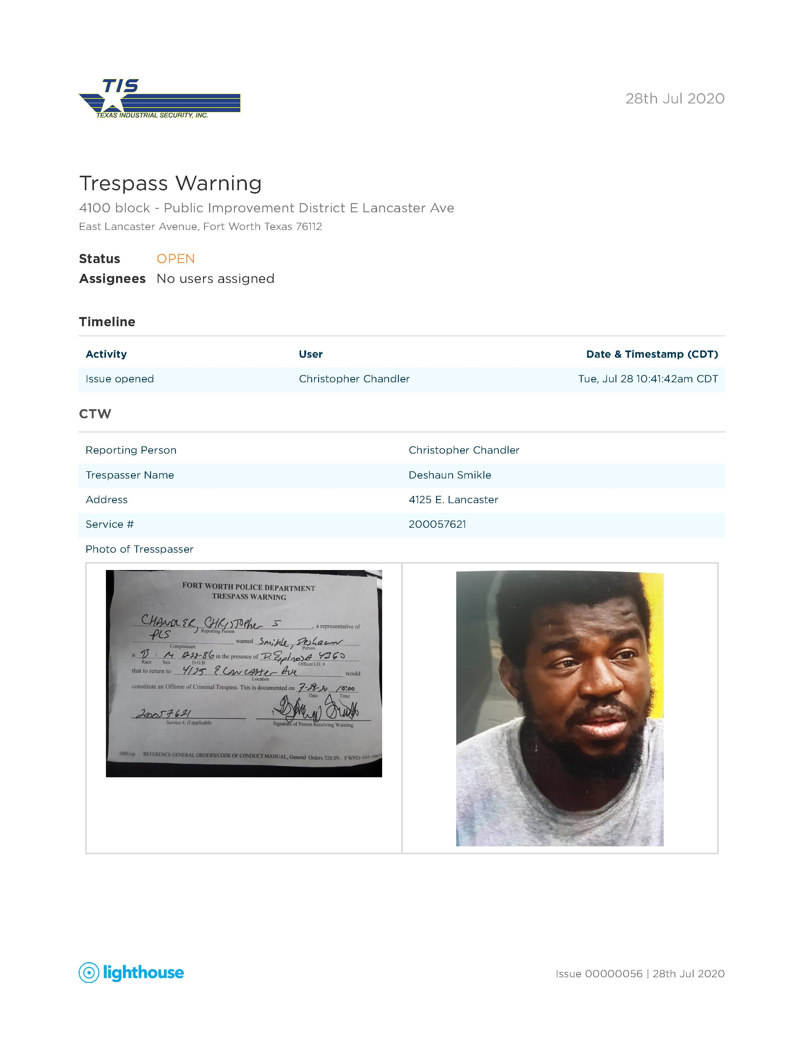
Guest Speakers
PID 20 Annual Meeting

Slide 13
Guest Speakers
PID 20 Annual Meeting

Slide 14
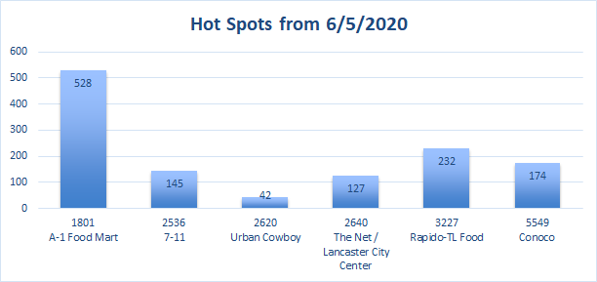
Guest Speakers
PID 20 Annual Meeting

Slide 15
Guest Speakers
PID 20 Annual Meeting
Dan Haase
PID 20 Supporter

Slide 16
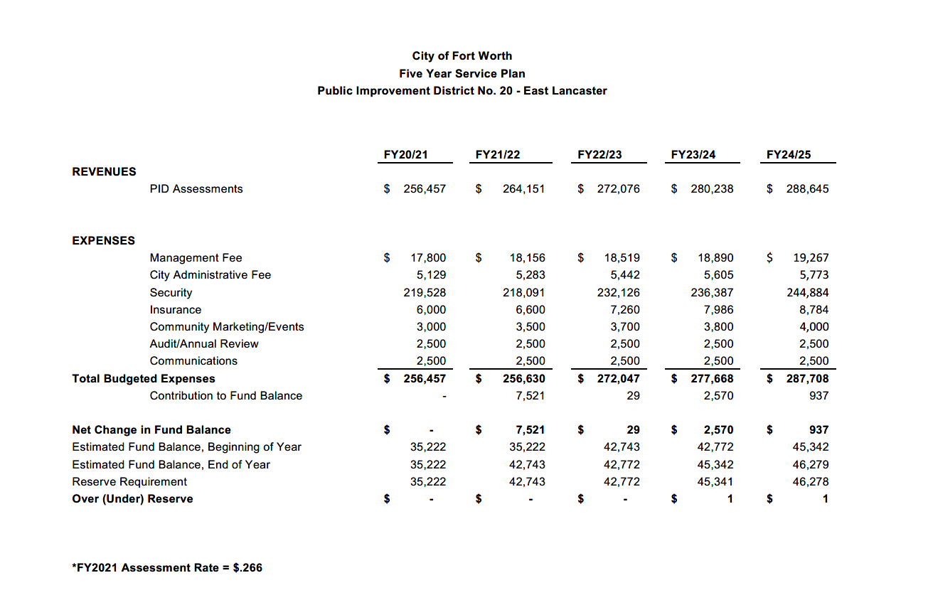
PID 2020-2021 Budget
To be approved by City Council
Notes:
Interior content slide

Slide 17
Open Forum
Questions and Answers
Open Discussion
Management will note comments in the minutes of the meeting
Questions for the board, management, city or police

Slide 18
Thank you for attending
PID 20 Inaugural Annual Meeting
Notes:
Section title slide option a

